Slide 1

HUM111 Pakistan Studies
Lecture 09

Slide 2
HUM 111 Pakistan Studies
Lecture 09
Land and People of Pakistan
Dr. Sohail Ahmad

Slide 3

Muslim World
Muslim world is vast and immense mass of land.
Spread from West Africa to Southern Philippines to Pacific.
Its northern limit touches the Volga in Russia while southern frontiers touch the Mozambique in southern east Africa on Indian Ocean.
In China, in addition to Sinkiang, Muslims are in substantial numbers, in the provinces bordering Burma and in districts around Peking.
Total population of the Muslim world is around one billion.

Slide 4
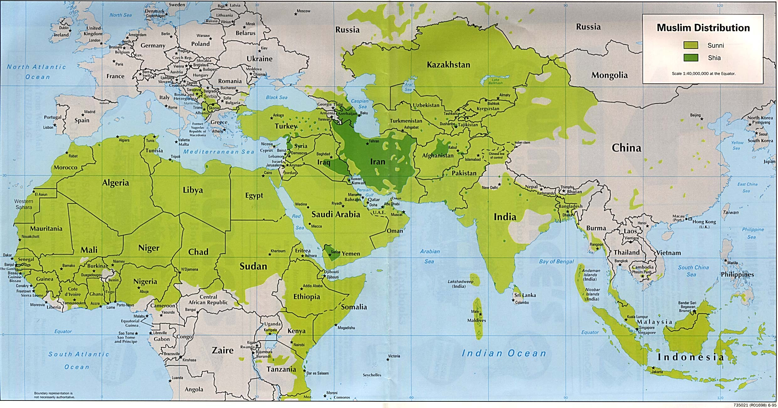

Slide 5
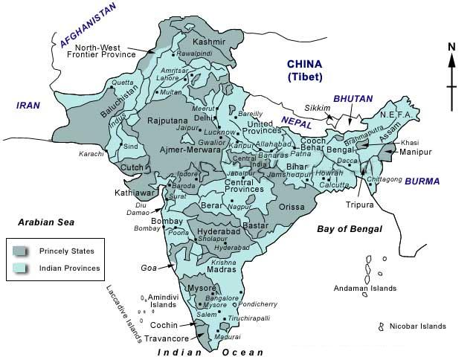
Geography and Culture [1/4]

Slide 6
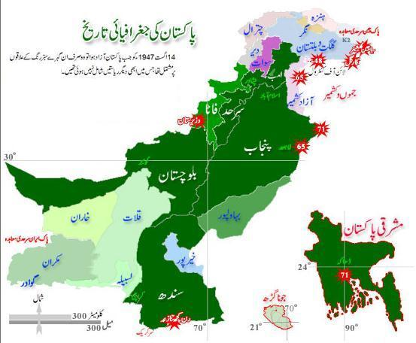
Geography and Culture [2/4]

Slide 7
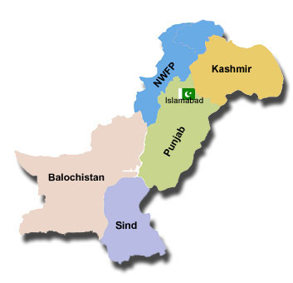
Geography and Culture [3/4]

Slide 8
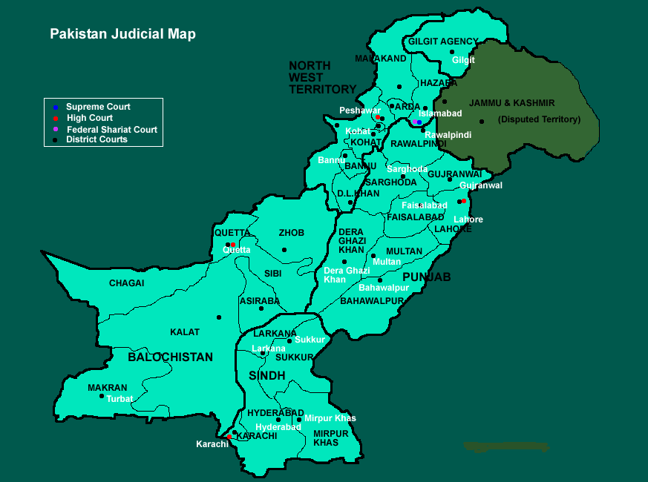
Geography and Culture [4/4]

Slide 9
Geography
Geography is the study of man's natural environment and how it influences his social and cultural development.
Geography with reference to territorial boundary of a state covers the study of following:
Region
Mountain
Desert
Sea
Plain
Rivers

Slide 10
Regions [1/3]
Punjab
Sindh
Khyber Pakhtunkhwa (KPK, Former N.W.F.P)
Baluchistan
Kashmir (Disputed territory)
Federally Administered Tribal Areas (FATA)
Gilgit-Baltistan

Slide 11
Regions [2/3]
Pakistan is the 36th largest nation by total area.
It is bordered by Afghanistan, Iran, India, and China.
Pakistan is also very close to Tajikistan, separated by the Wakhan Corridor.
Pakistan is strategically located between the regions of South Asia, Central Asia, and the Middle East.
This prime location – combined with varied natural resources, a diverse geography, and interesting environment – makes Pakistan a noteworthy country.

Slide 12
Regions [3/3]
Pakistan is one of the few countries in the world to have every kind of geological structure.
The geography of Pakistan is a blend of landscapes such as plains, deserts, forests, hills, and plateaus.
There are coastal areas along the Arabian Sea and mountains of the Karakoram Range in the northern part of Pakistan.
There are green mountains and dry mountains, land rich for cultivating, and waterfalls.

Slide 13
Mountains [1/6]
Himalaya
Karakorum
Hindukush
Sul-e-man Range

Slide 14
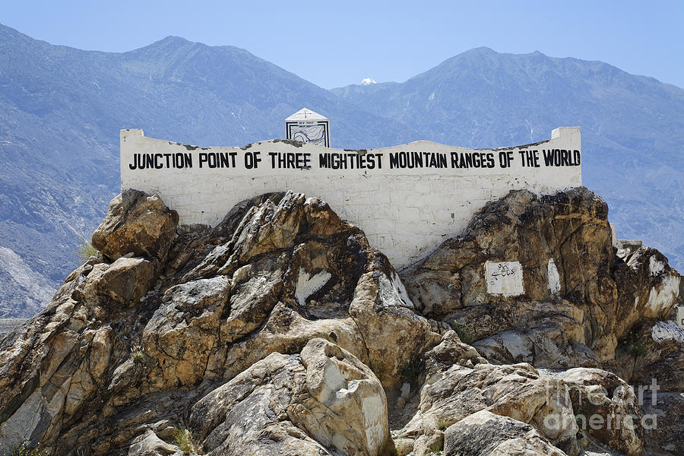

Slide 15
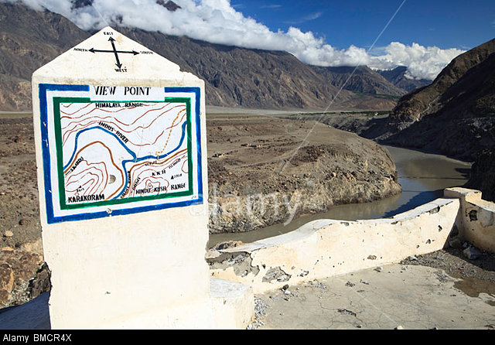

Slide 16
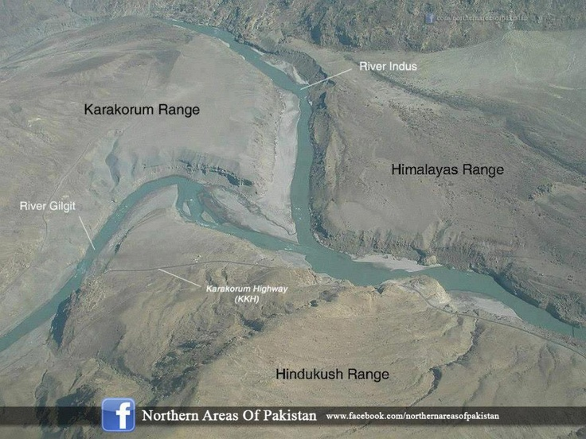

Slide 17
Mountains [2/6]
Due to its very high altitudes and sub-zero temperatures, these mountainous regions are also one of the most heavily glaciated part of the world outside the polar regions.
It consists of numerous ice glaciers including the world second and third longest glaciers, i.e., the Siachen Glacier (70 km) and the Biafo Glacier (63 km).

Slide 18
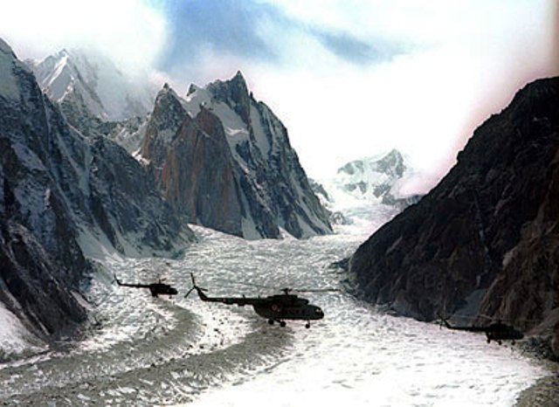
Siachen Glacier

Slide 19
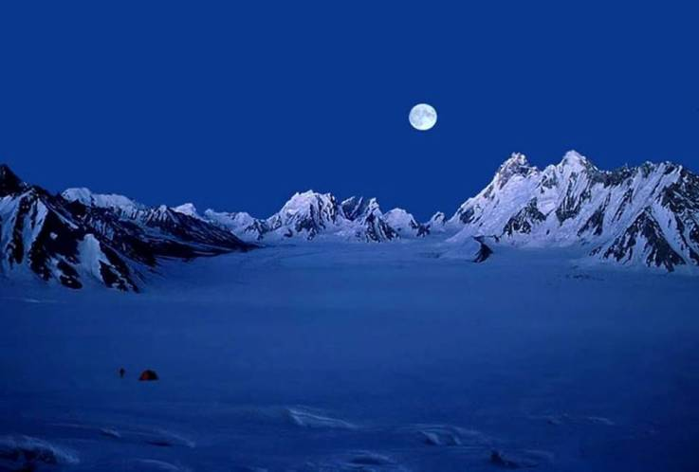
Biafo Glacier

Slide 20
Most of the text for these slides has been taken from www.insider.pk and www.pakistantoursguide.pk

